Slide 1
Introduction to API Usage
Noah Gallant
Jeffrey Dawson

Slide 2
Topics
What is an API?
Why use an API?
Constructing an API Request
What is a Script?
Writing a Script with API Usage
Examples / Practice

Slide 3
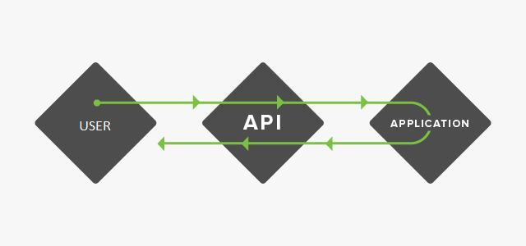
What is an API
A Communication Interface
Not Language Dependent
Request
Response

Slide 4
Purpose
Simple and Efficient Solution for Data Access
Processing Large Quantities of Data
Ex.
The Ocean Navigator API
Allows users and the navigator itself to obtain and make use of Ocean Data
Wolfram Alpha
Provides complex analytical tools
NOAA
Enables access to the NCDC’s Climate Data Online web service, which provides access to weather and climate data

Slide 5
Constructing an API Request
Base Url
Ex. http://navigator.oceansdata.ca/
API Component (2 types to pass parameters)
Using a Query
Ex. /api/v1.0/variables/?dataset=giops_day&3d_only
Using a Template
Ex. /scale/v1.0/giops_day/votemper/-5,30.png
Complex Requests?
Ex. /?query=%7B"area"%3A%5B%7B"innerrings"%3A%5B%5D%2C"name"%3A""%2C"polygons"%3A%5B%5B%5B62.27693797488524%2C‐53.94134521484374%5D%2C%5B59.98669914224615%2C‐36.80267333984375%5D%2C%5B56.180809047819764%2C‐37.681579589843736%5D%2C%5B56.434830853922364%2C‐55.96282958984374%5D%2C%5B62.27693797488524%2C‐53.94134521484374%5D%5D%5D%7D%5D%2C"bathymetry"%3Atrue%2C"colormap"%3A"default"%2C"contour"%3A%7B"colormap"%3A"default"%2C"hatch"%3Afalse%2C"legend"%3Atrue%2C"levels"%3A"auto"%2C"variable"%3A""%7D%2C"dataset"%3A"giops_day"%2C"depth"%3A0%2C"interp"%3A"gaussian"%2C"neighbours"%3A10%2C"projection"%3A"EPSG%3A3857"%2C"quiver"%3A%7B"colormap"%3A"default"%2C"magnitude"%3A"length"%2C"variable"%3A""%7D%2C"radius"%3A25%2C"scale"%3A“‐5%2C30%2Cauto"%2C"showarea"%3Atrue%2C"time"%3A823%2C"type"%3A"map"%2C"variable"%3A"votemper"%7D&format=png

Slide 6
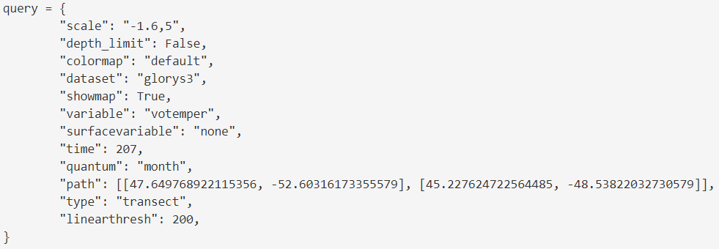
Using JSON
Ex.
Construct JSON Object
Encode Using Library (Encoded URI)
Concatenate base URL to Encoded URI
2018-07-09

Slide 7
Using the API in a Script: Why?
What is a Script?
A small program designed to execute simple repetitive tasks

Slide 8
Using the API in a Script: Why?
Allows dynamic changes
Versatile
Process large amounts of data
Ex.
Analyzing data over time
Creating GIF’s and other visual representations
Getting CSV/formatted data
Easier API Construction

Slide 9
Using the API in a Script: How?
Choose a Language / Prepare Environment
Import Libraries
Set Base URL
Construct JSON Object
Encode JSON Object
Concatenate Base URL
Send Request
Process Response

Slide 10
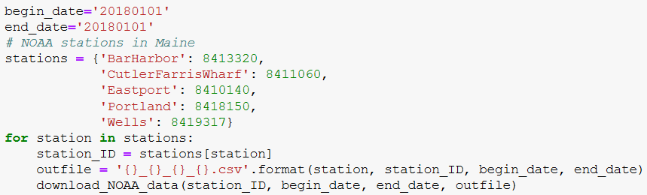
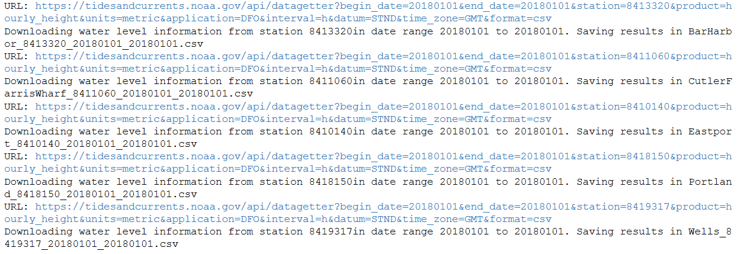
Other Applications?
NOAA API

Slide 11
Other Applications?
Social Media Dashboard
Uses API of different social media platforms, to display everything in one place.
Request for facebook post
Request to make a new post
Script that downloads every Donald Trump tweet as it becomes available
Script that searches for all tweets related to a certain topic

Slide 12
Example Scripts
Write a script that saves an image of the Flemish Cap transect for every variable in the GIOPS dataset
Write a Script that creates a GIF of the temperature of a specific area over 10 days
Write a Script that finds the max, min, and average temperature using the GIOPS Monthly Average dataset over a year for station 27

Slide 13
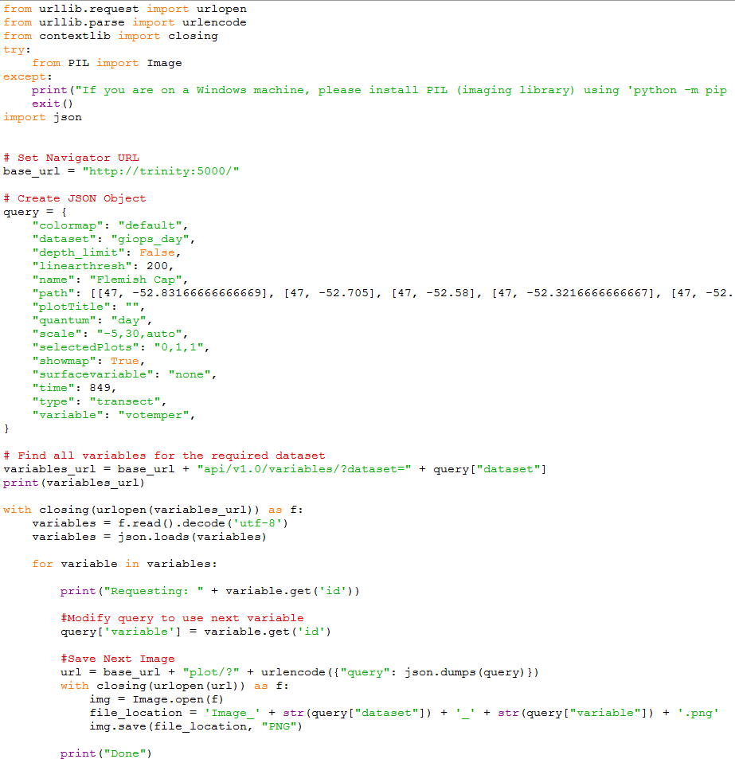
Example 1

Slide 14
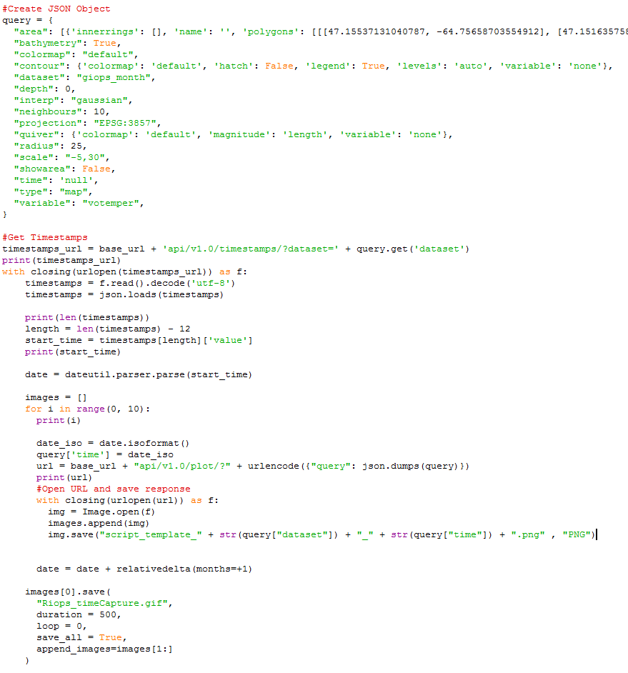
Example 2

Slide 15
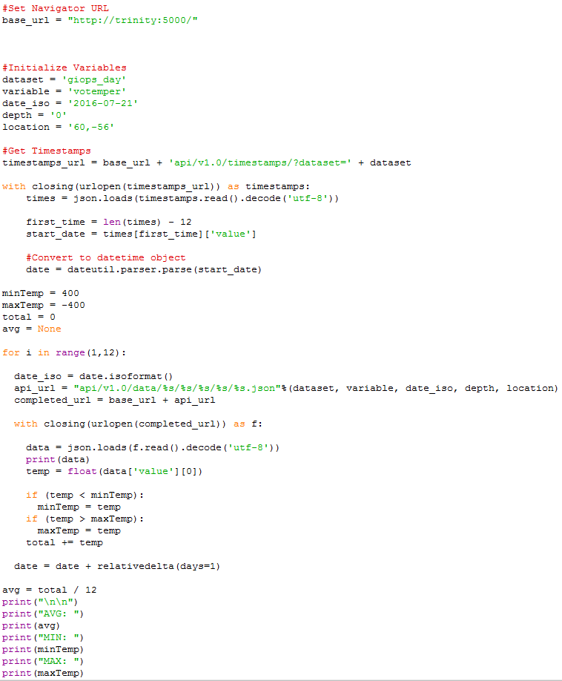
Example 3

